Slide 1
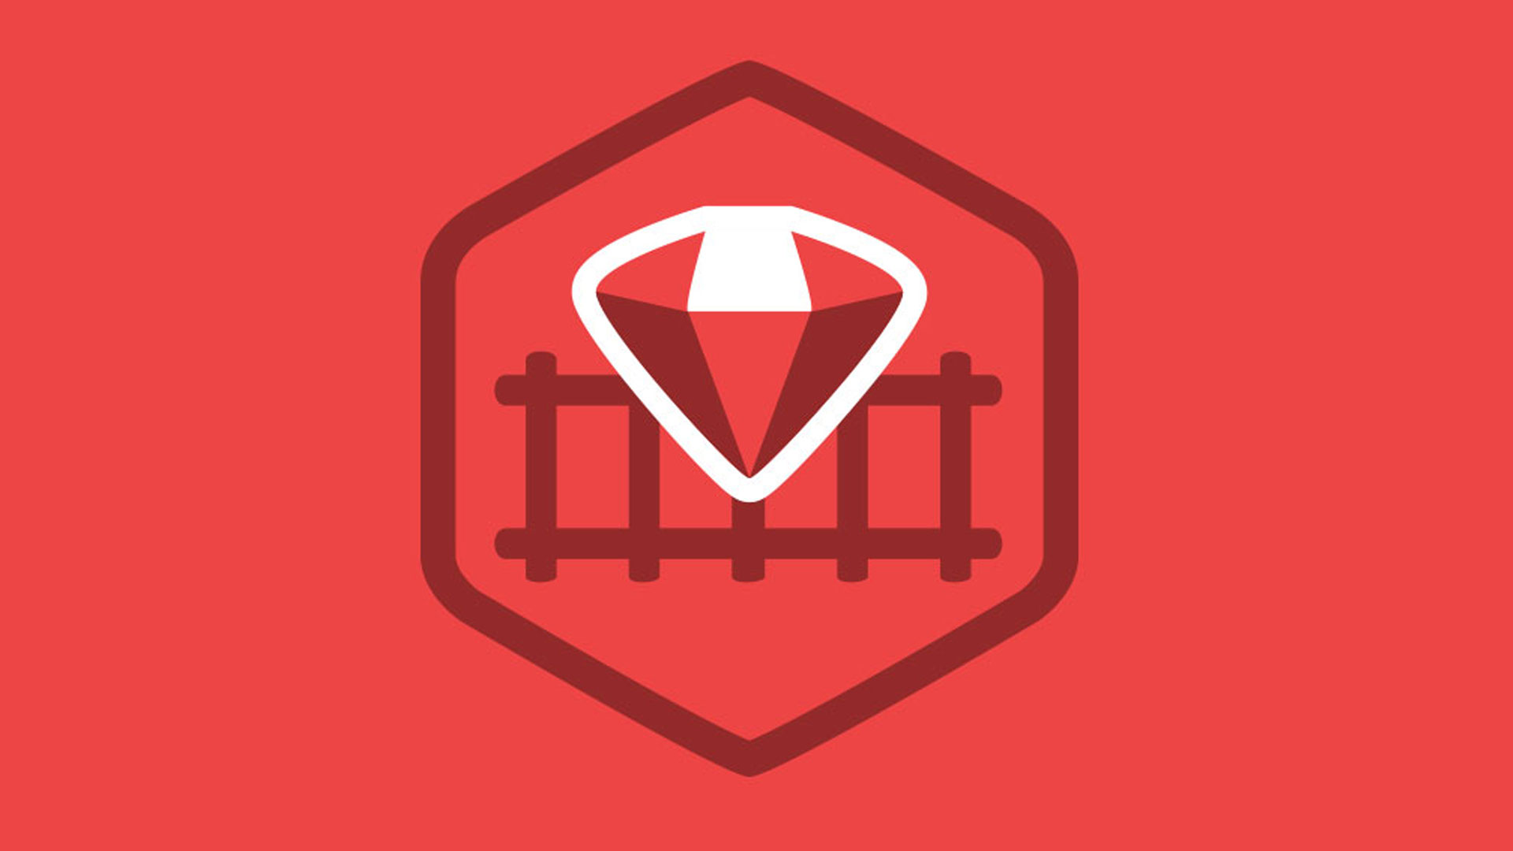
Ruby on Rails

Slide 2
About today…
Ruby on Rails
Importance of Monitoring and Debugging

Slide 4
Importance of Monitoring and Debugging
Ensure Application Stability
Proactively identify and resolve issues before they impact users
Improve User Experience
Detect and fix performance bottlenecks to provide a seamless experience
Enhance Security
Monitor for unusual activities that could indicate security breaches
Support Scalability
Ensure the application can handle increased loads by monitoring resource usage

Slide 5
Key Metrics to Monitor
Performance Metrics
Response Time
Measure the time taken to process requests
Throughput
Track the number of requests handled per second
Error Rate
Monitor the percentage of failed requests
Resource Utilization
CPU Usage
Monitor the CPU load to identify processing bottlenecks
Memory Usage
Track memory consumption to detect leaks or inefficiencies
Disk I/O
Measure read/write operations to detect storage bottlenecks
Availability Metrics
CPU Usage
Track the application's availability and downtime
Memory Usage
Measure the time taken for data to travel between the client and server

Slide 6
Tools for Monitoring Application Health
New Relic
Provides comprehensive performance monitoring and alerting
Prometheus
Open-source monitoring and alerting toolkit
Grafana
Visualization tool that integrates with various data sources, including Prometheus
Datadog
Cloud monitoring platform with infrastructure, application, and log management
Datadog
Industry-standard monitoring tool

Slide 7
Strategies for Debugging Issues
Reproduce the Issue
Understand the problem by reproducing it in a controlled environment
Use logs, error messages, and user reports to gather information
Use Debugging Tools
Pry
A powerful runtime developer console for Ruby
Byebug
An easy-to-use, feature-rich debugger for Ruby
Analyze Logs
Use logging frameworks like Lograge or Rails' built-in logger to capture detailed logs
Look for patterns or anomalies that indicate issues
Monitor Real-time Metrics
Use monitoring tools to observe application behavior in real-time
Identify spikes or irregularities in performance metrics
Use Profiling Tools
Rack Mini Profiler
Provides insights into request processing times
StackProf
A sampling call-stack profiler for Ruby applications
Collaborate with Team
Share findings and collaborate with team members to diagnose and
resolve issues

Slide 8
Best Practices for Continuous Monitoring
Automate Monitoring
Set up automated monitoring and alerting for key metrics
Ensure alerts are actionable and not too noisy
Regularly Review Metrics
Schedule regular reviews of monitoring dashboards and logs
Look for trends or deviations from normal behavior.
Test Monitoring Setups
Regularly test monitoring and alerting setups to ensure they work as expected
Implement Redundancy
Ensure redundancy in monitoring systems to prevent single points of failure
Train Teams
Train development and operations teams on using monitoring tools and interpreting metrics

Slide 9
Best Practices for Continuous Monitoring
Automate Monitoring
Set up automated monitoring and alerting for key metrics
Ensure alerts are actionable and not too noisy
Regularly Review Metrics
Schedule regular reviews of monitoring dashboards and logs
Look for trends or deviations from normal behavior.
Test Monitoring Setups
Regularly test monitoring and alerting setups to ensure they work as expected
Implement Redundancy
Ensure redundancy in monitoring systems to prevent single points of failure
Train Teams
Train development and operations teams on using monitoring tools and interpreting metrics

Slide 10


Slide 11

Introduction to Monitoring and Debugging
It ensures stability, improves user experience, enhances security, and supports scalability
What is the primary goal of debugging?
To identify and resolve issues in the application
Name two key performance metrics to monitor
Response time and throughput
What does CPU usage indicate in resource utilization?
The CPU load and processing efficiency of the application
Which tool provides comprehensive performance monitoring and alerting?
New Relic
What is a benefit of automating monitoring?
Automated monitoring ensures key metrics are consistently tracked and alerts are promptly generated

